Slide 1
Deep Learning in Antepartum Fetal Monitoring
Jaleed Khan
Jones Group
SPaM in Labour 2024
Notes:
Welcome, everyone. My name is Jaleed. I’m a postdoc in AI with the Jones Group at Oxford. Today, I’m presenting our deep learning work in antepartum fetal monitoring.

Slide 2
Overview
Introduction
Antepartum CTG
Hypothesis
The OXMAT Dataset
Methodology
Training Data and Cohort Development
Data Pre-processing
Model Architecture
Results
Future work
Conclusion
Notes:
I’ll start with the importance of antepartum CTG and present our hypothesis. I will give an overview of the OxMat dataset and present our methodology, including training data and cohort development, data pre-processing and model development. Finally, I’ll share our results, discuss the future work, and conclude the presentation.

Slide 3
Antepartum CTG
Among the commonest medical investigations performed during pregnancy
Monitors the Fetal Heart Rate (FHR) and uterine contractions (TOCO) before labour
Generally used for detecting fetuses in a state of wellbeing or at risk of an adverse outcome
Visual interpretation of CTGs is long-known to be unreliable, with inter-observer agreement as low as 29% and a false positive rate of ~60%
Current computerised assessment, done with the Oxford Dawes-Redman System, is limited to wellbeing only
Our Hypothesis: AI applied to antepartum CTGs (aCTGs) will improve the detection of both healthy babies and those at an increased risk of adverse pregnancy outcomes
Notes:
Antepartum CTG is a common medical investigation performed during pregnancy, which monitors the Fetal Heart Rate (FHR) and uterine contractions (TOCO) before labour
It’s used to detect fetuses in a state of wellbeing or at risk of an adverse outcome.
The visual interpretation of CTGs is highly subjective and unreliable, with inter-observer agreement as low as 29% and a false positive rate around 60%. This inconsistency can lead to unnecessary interventions or missed opportunities to prevent adverse outcomes.
Currently, computerized assessment is done with the Oxford Dawes-Redman System, but it is limited to assessing wellbeing only.
Our hypothesis is that applying AI to antepartum CTGs will improve the detection of both healthy babies and those at an increased risk of adverse pregnancy outcomes.

Slide 4

The OXMAT Dataset
The Oxford Maternity Dataset (1991–)
211,000+ CTGs
250,000+ pregnancies
~250 clinical variables
Maternal and neonatal outcomes, Apgar scores, CBG values, birthweights, delivery, medications, ...
OXMAT
Notes:
My colleague Ioana already presented the OxMat dataset in detail this morning in her talk. I’ll just give a quick overview!
OxMat is a curated collection of CTGs, which contains over 211 thousand CTG recordings from more than 250 thousand pregnancies collected since 1991.
It includes around 250 clinical variables that provide nearly complete data on critical maternal and neonatal outcomes such as Apgar scores, CBG values, birthweights, and delivery medications to name a few.
The completeness and scale of the OxMat dataset offer a solid foundation for developing AI-driven technologies to improve maternal and fetal health.
210k+ CTGs, 70k+ pregnancies, 200+ clinical var (old)
211k+CTGs, 250k+ pregnancies, and ~250 variables

Slide 5
Training Data and Cohort Development
Inclusion criteria:
Gestational age between 27⁺⁰ and 41⁺⁶ weeks
Known fetal sex
Maternal BMI between 15 and 40 kg/m²
Time before delivery of APO/Cases within 7 days
Exclusion criteria:
Duplicate CTGs or multiple CTGs from the same day
Indeterminable time the CTG was performed relative to delivery
OXMAT
Notes:
To select a representative and balanced sample of the dataset for model training and validation, we defined specific inclusion and exclusion criteria.
We included CTGs from pregnancies with gestational ages between 27 and 41 weeks.
We ensured that the fetal sex was known, and maternal BMI was between 15 and 40.
For the cases cohort, we constrained the time before delivery to within 7 days to focus on the most relevant period.
We removed duplicate CTGs or multiple CTGs from the same day to avoid redundancy.
CTGs with indeterminable timing relative to delivery were also excluded.

Slide 6
Training Data and Cohort Development
Categories:
Adverse Pregnancy Outcomes (APO) Cases: Specific adverse outcomes such as stillbirth, neonatal death, severe hypoxia, low Apgar scores, and NICU admission
Normal Pregnancy Outcomes (NPO) Controls: Normal pregnancy outcomes without adverse events
Matching using propensity scores based on confounding variables gestational age, fetal sex, maternal BMI, and other key covariates
OXMAT
Notes:
We categorized the data into two groups: Adverse Pregnancy Outcomes (APO) or Cases, and Normal Pregnancy Outcomes (NPO) or Controls.
The cases include specific adverse outcomes such as stillbirth, neonatal death, severe hypoxia, low Apgar scores, and admission to Neonatal Intensive Care Unit (NICU).
The controls represent normal pregnancy outcomes without any adverse events.
By defining these groups, we aim to develop a model that can accurately distinguish between normal and adverse outcomes.
For matching, we used propensity scores based on confounding variables like gestational age, fetal sex, and maternal BMI, to create balanced cohorts for model development.

Slide 7
Training Data and Cohort Development
Final Dataset for Model Development:
19,462 CTGs (9,731 in each category)
80-20 train-test split
Pre-processing Steps:
Adjust FHR (50-250) and TOCO (0-100) values
Normalize FHR and TOCO values to [0.0, 1.0]
Segment and/or pad signals to standard 1-hour segments
20,589 CTGs (10890 NPO/Controls and 9699 APO/Cases)
OXMAT
Notes:
After applying the inclusion and exclusion criteria and performing matching, we arrived at our final dataset for model development, which consists of 19,462 CTGs, split equally between cases and controls.
We performed several pre-processing steps to prepare the dataset for model training.
We adjusted and normalized Fetal Heart Rate and Uterine Contraction signals to bring them within a practical range.
We segmented longer CTG signals and padded shorter CTG signals into standard 1-hour segments to make the input signal lengths consistent for modelling.
After pre-processing, we had a resulting dataset of 20,589 CTGs, which we used to train and test our model.

Slide 8
Model Architecture
Hyperparameter Optimization for Model Design:
Objective: Maximize Validation AUC
Number and configuration of DNN Layers, including 1D CNN, LSTM, Transformer and Dense layers
Training options, including learning rate, batch size and optimizer
Notes:
To develop an optimal deep learning model, we began with a process called hyperparameter optimization, which means we tried different configurations to find the best combination of deep learning layers and training options that would maximize the performance in terms of Validation AUC. A higher AUC means better model performance in distinguishing between normal and abnormal CTGs.
We experimented with various types of layers: Conv1D layers extract local features from time-series data, LSTM layers capture long-term dependencies, and Transformer blocks leverage self-attention mechanisms to focus on the most important parts of the signals.
Apart from the layers, we tuned the hyperparameters, such as the internal configuration of each layer, the the learning rate (which determines how quickly the model updates its parameters during training), batch size and optimizer.

Slide 9
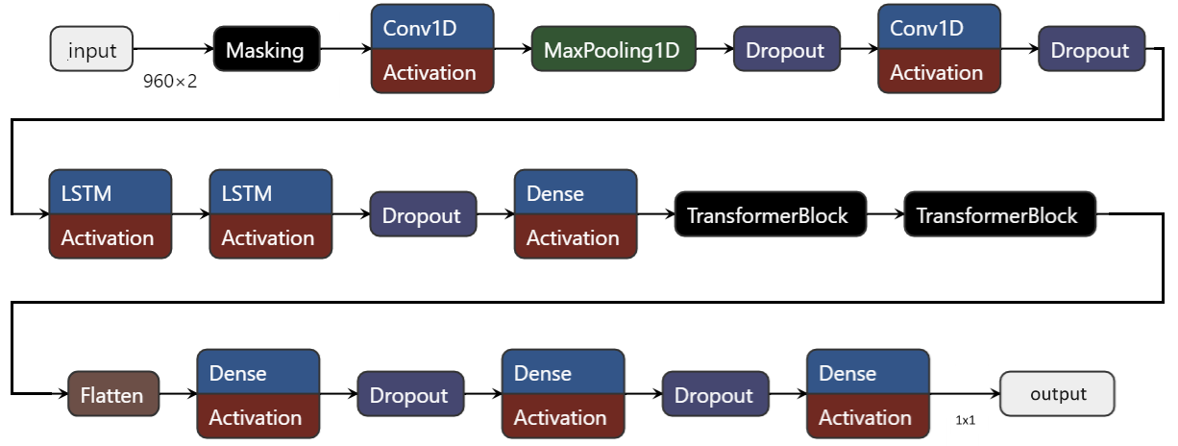
Model Architecture
The Optimal Model for aCTG classification:
Notes:
Our optimal deep learning model for CTG analysis starts with a masking layer to handle masked values in the input signals.
The input to the model is a pair of FHR and TOCO signals, and the output is the probability of the CTG belongs to either a normal or adverse outcome category.
The model includes multiple layers that we just discussed: 1D CNN, MaxPool, Dropout, LSTM, and Transformer blocks.
By combining the different types of layers, we leverage the strengths of each to build a robust model that captures representative sequential features of the CTG signals for making predictions.

Slide 10
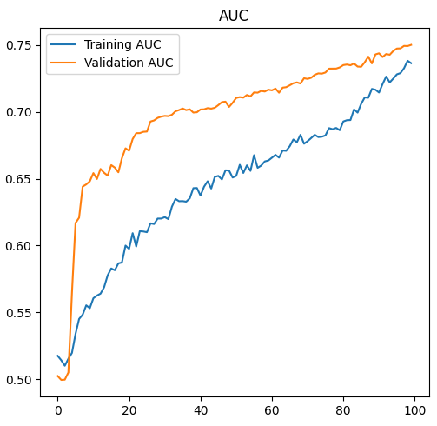
Results
Smooth convergence to ~0.75 AUC during model training
Notes:
We trained the model 100 epochs. An epoch is one pass through the training dataset.
As we trained the model, we monitored the performance to ensure the model was learning and adapting as it processed new data over time.
We observed a smooth convergence to an AUC of about 0.75 at the end. AUC measures how well the model can distinguish between normal and abnormal CTGs. An AUC of 1 means perfect performance, while an AUC of 0.5 means no better than random guessing. The smooth convergence of the plots indicates that the model was learning effectively and generalizing well to the unseen validation data.

Slide 11
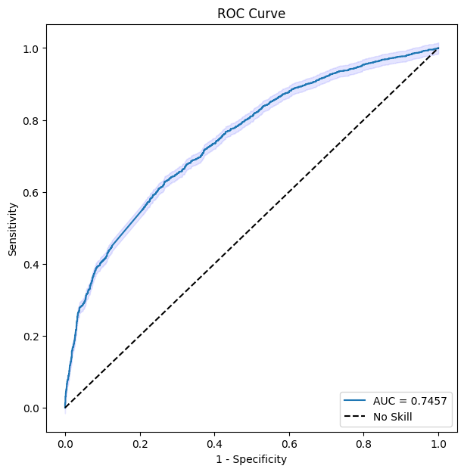
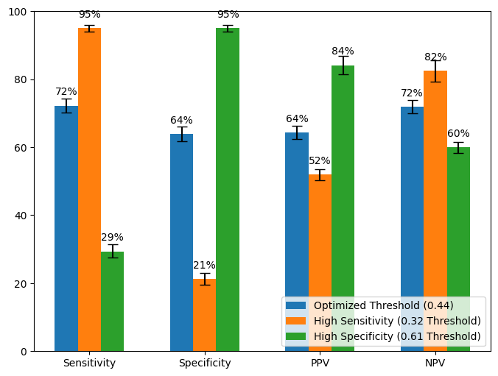
Results
Notes:
After training, we tested our model on the test data. The model achieved an AUC of 75%, which means it can effectively distinguish between normal and abnormal CTGs. The ROC curve on the left shows the performance across different thresholds, which is consistently above the random guessing line.
The graph on the right shows performance metrics, including sensitivity, specificity, positive predictive value and negative predictive value, at different thresholds: optimized (blue), high sensitivity (orange), and high specificity (green). It shows trade-offs between detecting abnormalities and reducing false positives. The error bars represent confidence intervals for each metric.
In high sensitivity mode, the model detects most abnormalities (95% sensitivity) but has a higher false positive rate (21% specificity).
In high specificity mode, it correctly identifies most normal cases (95% specificity) but misses many abnormalities (29% sensitivity).
The results at the optimized threshold shows a good balance between sensitivity and specificity, which shows the potential of our model to improve antepartum fetal monitoring by accurately classifying CTGs.

Slide 12
Future work
Perform benchmark comparison with the Oxford Dawes-Redman system
Incorporate state-of-the-art DNN architectures for better time series analysis
Identify potential abnormal outcomes and extend the model to detect specific adverse pregnancy outcomes using advanced DNN architectures
Perform external validation of the model on international CTG datasets from collaborations in Australia and India
Collaborate with clinicians to review and validate identified outcomes, and ensure integration into clinical workflows
Notes:
The future work will focus on benchmarking against the..

Slide 13
Conclusion
Antepartum CTG is crucial for monitoring fetal health and preventing adverse outcomes
Our deep learning model achieved an AUC of 0.75, showing promising performance in classifying normal and abnormal aCTGs
Future work includes benchmarking our model against the DR system and extending it to detect specific adverse outcomes using state-of-the-art DNNs for time series
Validation on international datasets and collaboration with clinical experts will ensure broader applicability and integration into clinical practice
Notes:
To summarize the main takeaways

Slide 14

Acknowledgement
Gabriel Davis Jones
Chris Redman
Ioana Duta
Beth Albert
Pawel Szafranski
James Bland
Manu Vatish
Notes:
I would like to take a moment to acknowledge the funding support from Medical Research Council, and everyone who made this work possible. The contribution and expertise of all team members have been essential to the progress we've made so far.

Slide 15
Thanks!
Notes:
Thank you for your attention. I’m happy to take any questions.

